Slide 1
The battle of the neighborhoods
Which neighborhoods in the Stockholm area are better suited for relocation given activities of interest and accommodation prices

Slide 2
Evaluating relocation options within Stockholm neighborhoods
There is 4 things Swedes really enjoy doing, according to what I have observed during my time living in Stockholm. To 'Fika’ (gather up for a coffee or tea and something small to eat). Outdoor activities such as hiking, skiing or bathing in the lakes. Drink and dance (with local breweries growing in popularity). Eating out in restaurants around the neighborhood.
This project aims at identifying clusters of similar neighborhoods in Stockholm taking into account the availability to carry on one or more of the previously mentioned activities. Additionally, the report will try to contrast these clusters with the average municipality accommodation prices. By doing so, the goal is to help people living in Stockholm to identify which neighborhood better match their profiles, and which ones would be a better option for them if they decide to relocate within Stockholm.
This project would be of interest to real state companies or real state websites looking to help its clients when relocating / searching for new places to live within Stockholm

Slide 3
Data Collection
Following data sources will be needed to extract/generate the required information:
Stockholm counties and komuns/municipalities [1]
Wikipedia for scraping neighborhood names from a given komun [2]
Google Maps API geocoding for finding the locations of each neighborhood [3]
Foursquare API for finding venues and venue categories around a given point [4]
Hemnet website for scraping house prices within komuns [5]

Slide 4
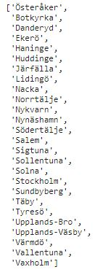
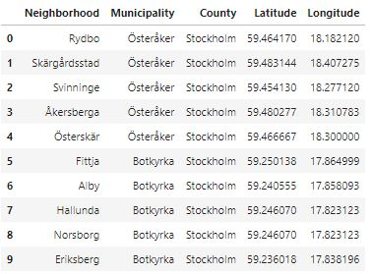
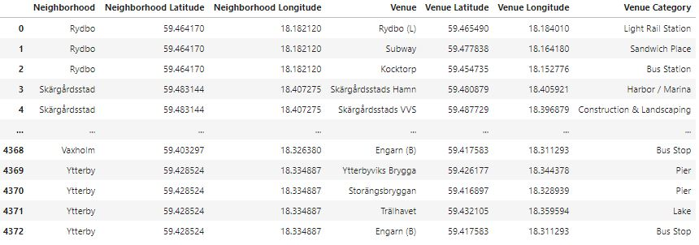
Collecting Stockholm’s municipalities, neighborhoods, locations and venues
Fetching neighborhoods and locations given komun names
Collecting venue information and its locations around neighborhoods
Komuns/municipalities from Stockholm

Slide 5
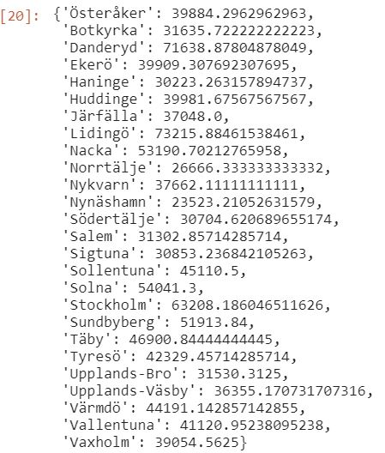
Collecting average house prices from Stockholm’s komuns
Website www.hemnet.se is used for scrapping average house prices per sqm in each of Stockholm’s komun. Hemnet is the main real state website used in Sweden for searching apartments to buy.

Slide 6
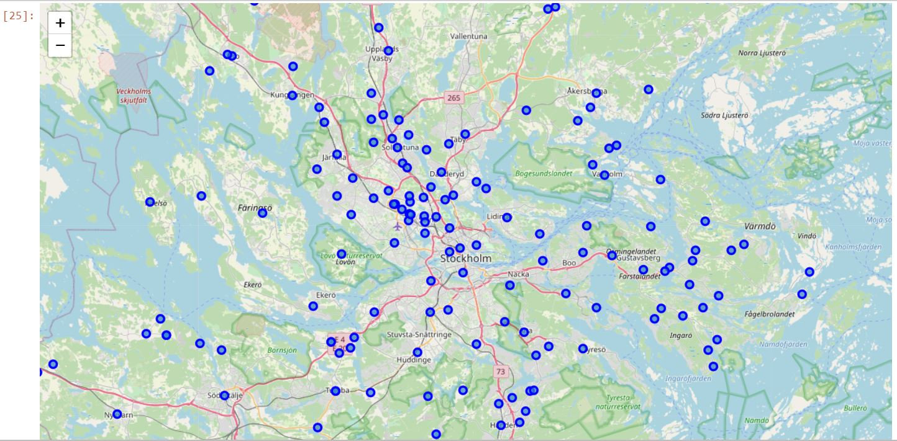
Visualizing neighborhoods on Stockholm Map

Slide 7
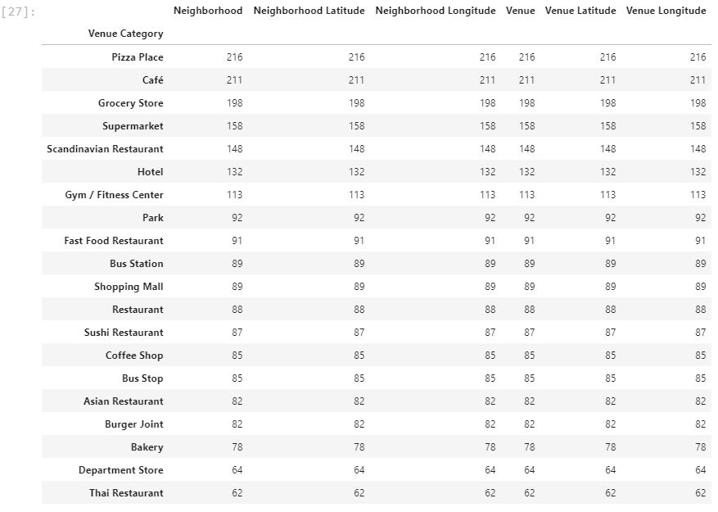
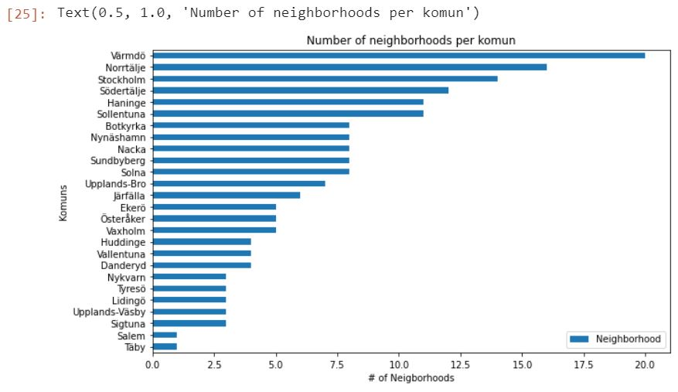
Visualizing # of neighborhoods per municipalities and counts per venue categories

Slide 8
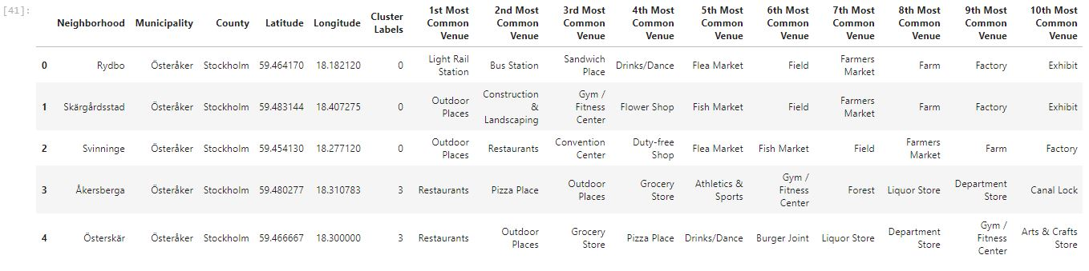
Machine learnings
We use unsupervised machine learning for making some sense out of the data. Specifically, we use the K-means clustering algorithm with 5 k clusters. Neighborhoods are clustered based on venue categories. By doing this, we will identify neighborhoods with similar profiles in terms of which activities can one carry on there
After clustering have been applied to the data, cluster labels are assigned to each neighborhoods.

Slide 9
Results
Examining the 5 clusters obtained:
Cluster 0 [in red]. We can see that in almost every neighborhood, the most common category is 'outdoor activities', which suggests these neighborhoods have many open spaces around with outdoor venues to utilize.
Cluster 1 [in purple]. A key differentiator for this cluster of neighborhoods is the fact that in almost all of them, the four most common venues are venues within the 4 activities being analyzed in this report: restaurants (eat out), Fika, Outdoor places and Drinks/Dance. This suggests that you have many venue options within all these activities in the neighborhoods of this cluster.
Cluster 2 [in light blue]. The neighborhoods in this cluster have a clear differentiator. The two most common venues are constantly restaurants and fika venues. Another thing to notice is that there doesn’t seem to be many places to drink and dance within venues in these neighborhoods
Cluster 3 [in light green]. This cluster is probably the least clear at simple sight. Restaurants seem to be the most common venues within the neighborhoods. Fika venues seem to be present in the top 10 most common venues every time but are more disperse than in other clusters. Some neighborhoods show them in the top 3 and some in the bottom 10. Outdoor places are quite mixed between neighborhoods of this cluster, either being in the top 5 most common venues or not being there at all. Places to drink and dance and outdoor places, are noticeably less common within this cluster.
Cluster 4 [in yellow]. This cluster clearly has Restaurants and fika venues as the most common types of venues within the neighborhoods. One can notice that Outdoor places and Drink/Dance places are almost always present in the top 10 most common venues. This suggests that within all 4 activities we can find several venue options in the neighborhoods of this cluster. A key difference between this cluster and cluster 1 is that in cluster 1, venues within the 4 activities described in the report were almost all the time in the top 4 most common venues. In cluster 4, Outdoor places and Drink/Dance places are, although always present in the top 10, not always in the top 5 most common venues. This suggest that although you can drink and perform outdoor activities within these neighborhoods, there are not as many venues of this types as in cluster 1

Slide 10
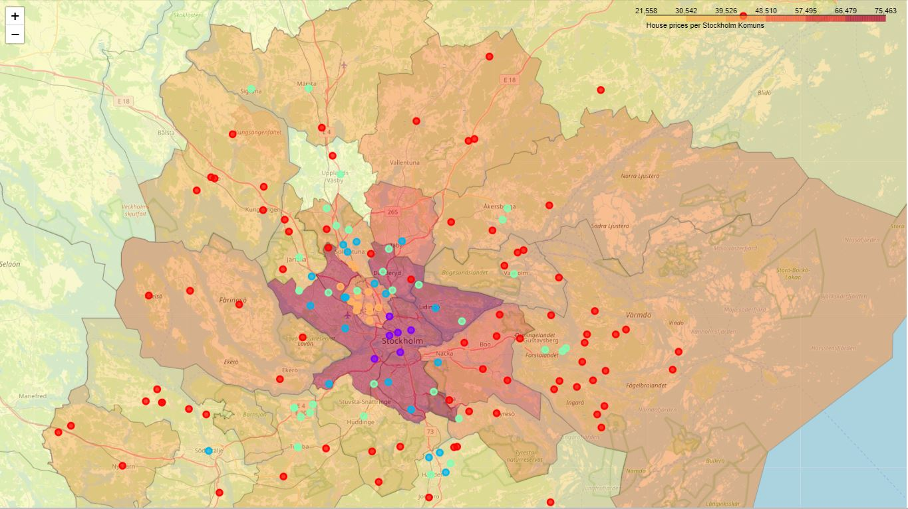
Results
Showing cluster of neighborhoods in Stockholm’s map. They are contrastred in a choropleth map showing average house prices per Stockholm komun

Slide 11
Discussion
Key observations within the results
Most of the neighborhoods in the outskirts of the Stockholm area belong to cluster 0, where the most common activity is outdoor activities. This seems logical since there is a lot of nature and water around those areas. Also, the average price for accommodation in those areas is low.
If a person is really interested in relocating to a neighborhood where there are many options available for restaurants and fika, but do not have a very high income, agencies could recommend neighborhoods belonging to cluster 2.
There are persons that are interested to have a little of everything around, meaning that they would like to have restaurants to eat out, places to fika, outdoor activities and availability to go drinking / Dancing. There is a clear cluster of neighborhoods (cluster 1) where venues for these activities are almost always the four most common overall. However, average house prices in these neighborhoods are super high.
There is an alternative, however, for people with interest in all four activities and an average income. Neighborhoods within cluster 4 have a lower house average price but they still fulfill the requirement of having venues around for all four types of activities. Difference with cluster 1 is that you have more limited options and might have to walk farther distances, for example, to reach a venue where you can drink or dance. People might be willing to accept that trade off, however, given the reduced housing prices in these areas.

Slide 12
Conclusion
The goal of this project was to try to identify similar neighborhoods based on the possibility to eat out, fika, drink/dance and carry out outdoor activities in outdoor venues. Based on this, together with average house prices in the neighborhoods, the project aimed to serve as a tool for agencies to recommend relocation possibilities. Using unsupervised machine learning with k-means clustering, we were able to differentiate and group together neighborhoods offering one, two or all four activities together, with both medium and high average housing prices.

Slide 13
References
[1] Sweden's Counties and komuns
[2] Sweden's Neighborhoods per komun
[3] Google Maps API geocoding
[4] Foursquare API
[5] Hemnet for Sweden's house prices
[6] Sweden's komuns geojson spatial data

